Slide 1


Blockchain-based
Remote Electronic Voting

Slide 2
ToC
Electronic Voting (EV)
  Definitions and Notions with a Global Overview on EV
  History of Switzerland and REV
  Focus on Remote Postal Voting (RPV) in Switzerland
Remote Electronic Voting (REV)
  REV Requirements and Properties
  Security Building Blocks
    Homomorphic Encryption, ZKP, PBB
BC-based REV
  Provotum Voting Protocol and Evaluation
Summary

Slide 3
Electronic Voting
Notes:
Cloud computing
- History / Definition / characteristics
- IaaS, PaaS, …
Virtualization
- TBD (GM)
3

Slide 4
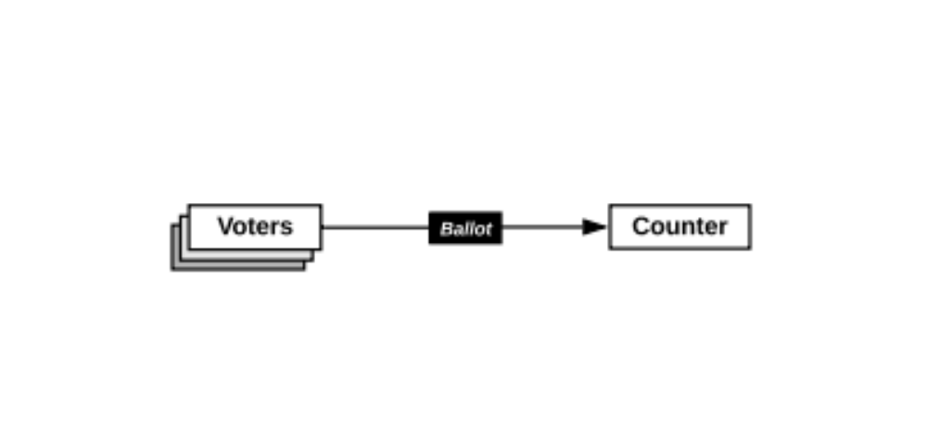
Aren‘t elections just counting?
Main difficulties in practice
  No one is trusted
    Anyone is a potential adversary
  The need for evidence
    Any observer should be able to verify the election data
  The secret ballot
    Voters should not be able to prove how they voted to anyone, even if they wish to do so

Slide 5
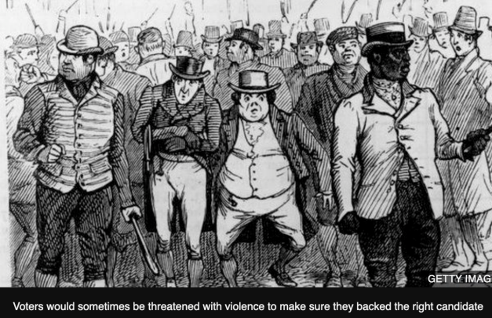
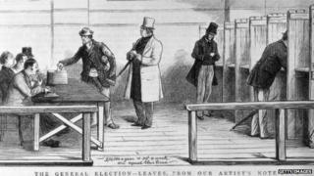
The Secret Ballot
Mid 19th century, the “Australian ballot” was introduced as a means of deterring coercion
Today, society takes for granted this process of voting privately within a public environment, where observers can enforce privacy, but great innovation in its time
In the early 1980s, cryptographers began to propose new election designs with new properties and integrity guarantees
Source: https://www.bbc.com/news/uk-england-leeds-31630588

Slide 6
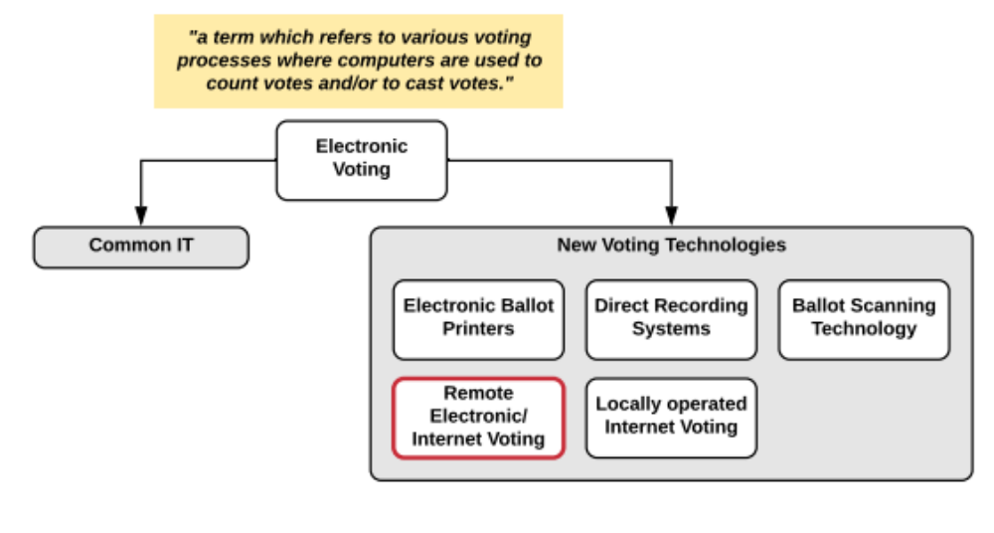
Terminology
Remote Electronic Voting (REV) or Internet Voting
  Vote cast in a remote, uncontrolled environment and not in a voting booth.
Notes:
Governmental Processes include EV, often not realized
Common IT already EV, this work REV
REV continuously refined but not many REV in RW
Still not many REV, many reasons, two of them
Complexity and
Trust and Transparency issues with solutions and providers

Slide 7
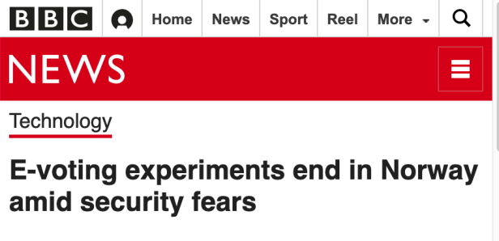
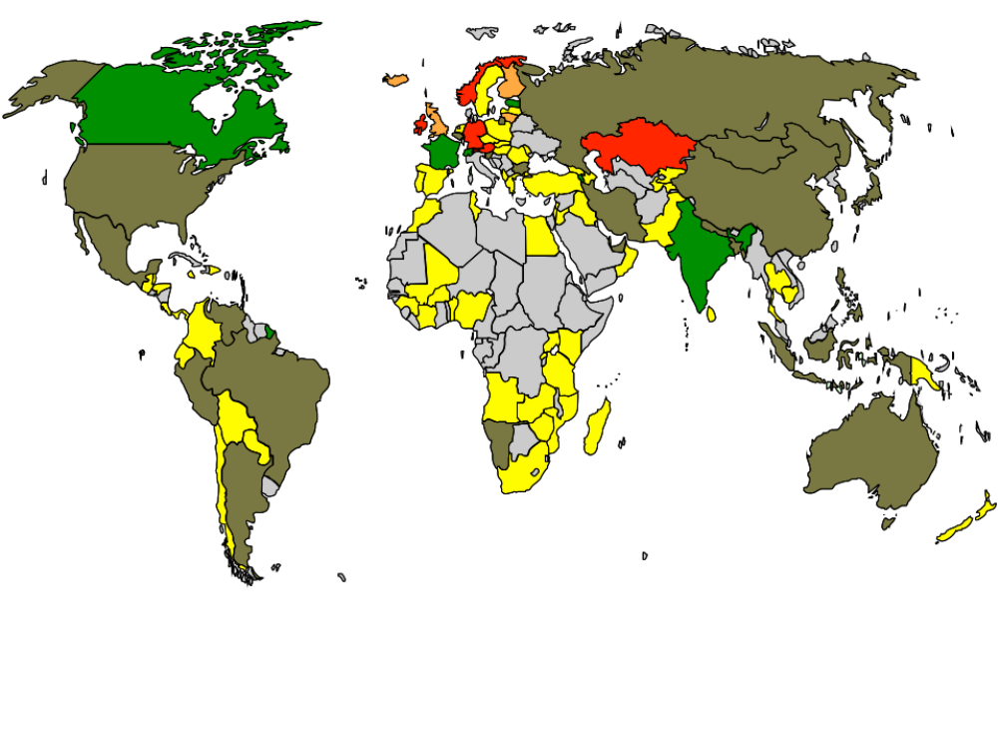
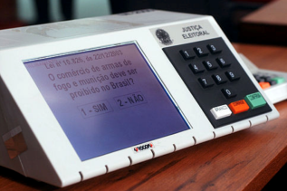
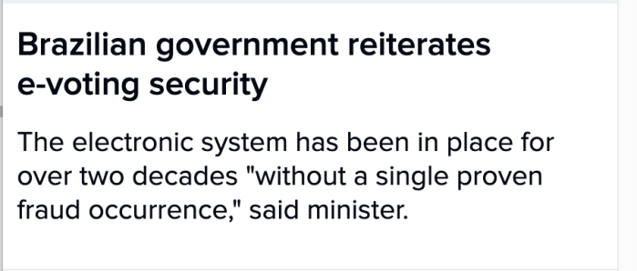
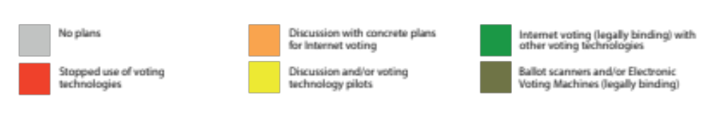
E-Voting World Map
Source: e-voting.cc

Slide 8
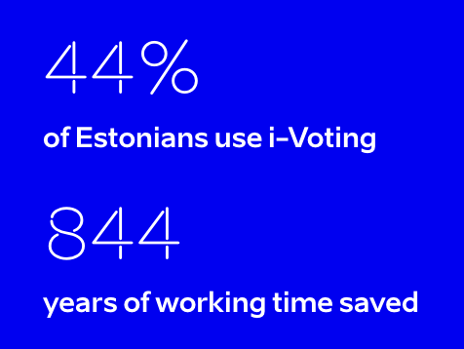
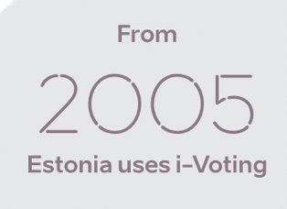
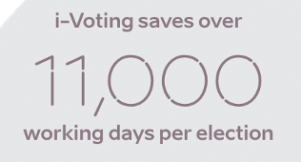
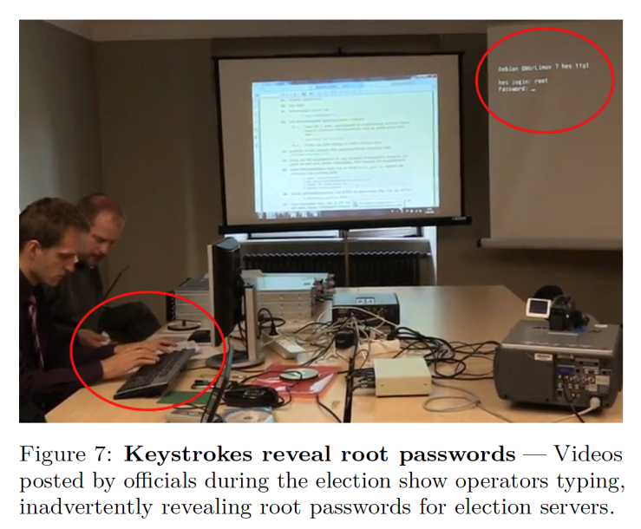
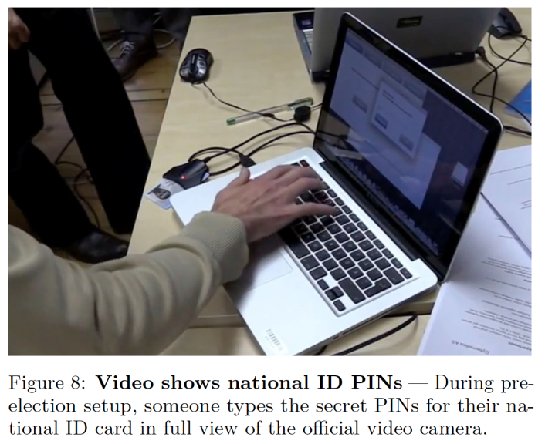
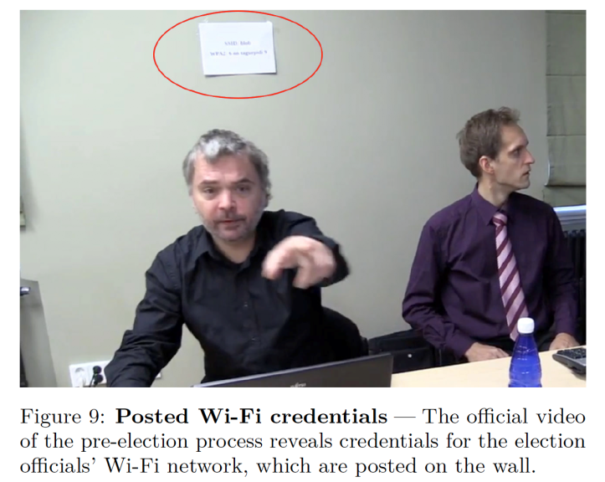
Estonia
Source: Security Analysis of the Estonian Internet Voting System, Drew Springall et al., November 2014

Slide 9
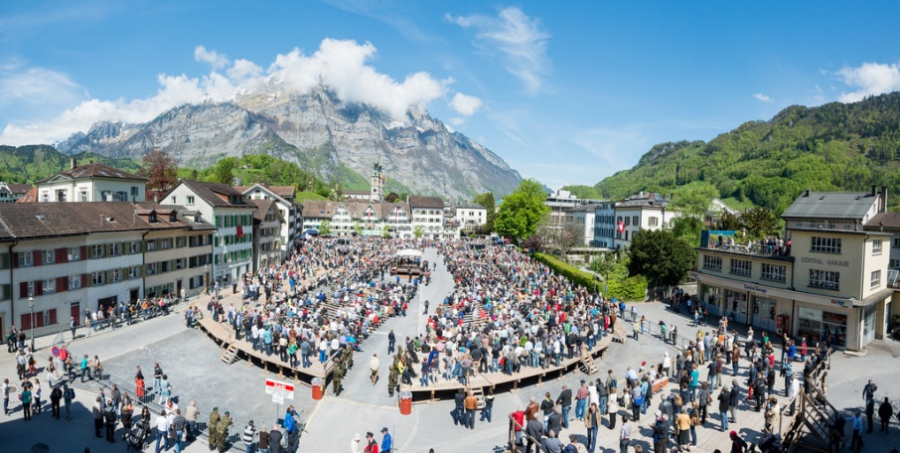
Brief History of Swiss Voting Channels
A tradition of direct democracy (Landsgemeinde)
  Introduction of “Remote Postal Voting” in the 1970’s which was generalized in the 1990’s
  1998: the Federal Council proposes to study Internet Voting (I-Voting) and by the year 2000, official start of the Vote “électronique” project with three pilot cantons (GE, NE, ZH)
Image: Samuel Trümpy Photography, https://www.gl.ch/landsgemeinde.html/216
Source: https://www.bk.admin.ch/bk/en/home/politische-rechte/e-voting/chronik.html

Slide 10
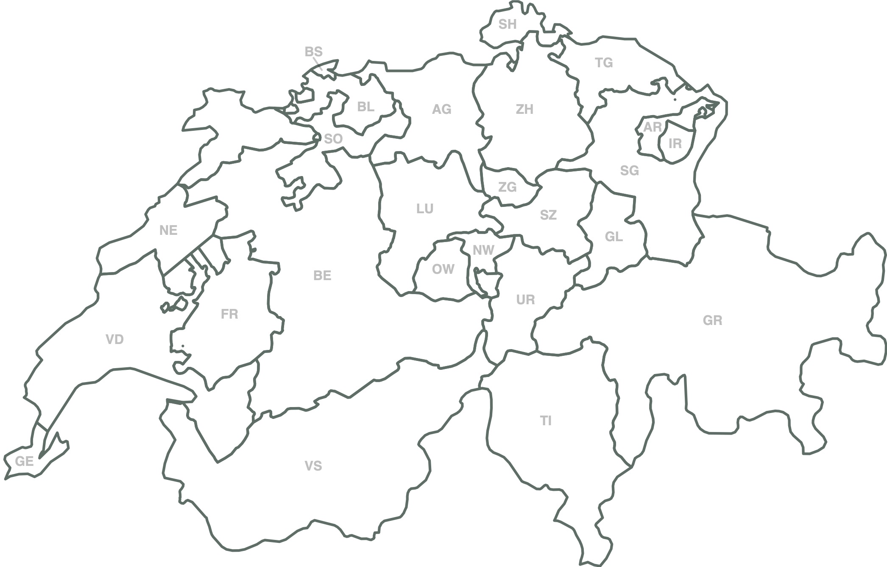
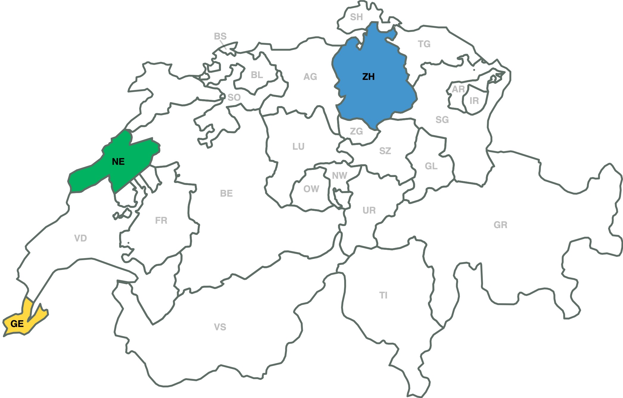
First Trials, Initial Pilot Phase
2004 Zurich System
first trials for federal votes
2005 Neuchâtel System
first trials for federal votes
2004 Geneva System
first trials for federal votes

Slide 11
Extension of Trials
In 2006, the Federal Government opened the door for all cantons to use limited internet voting:
  20% of the cantonal electorate (later extended to 30%);
  10% of the federal electorate
Geneva and Zurich (Vote Consortium) started offering their system to other cantons
  Some drawbacks were also experienced:
    Regulatory issues in Geneva (2005 – 2007)
    Technical issues in Zurich (2011 – now)

Slide 12
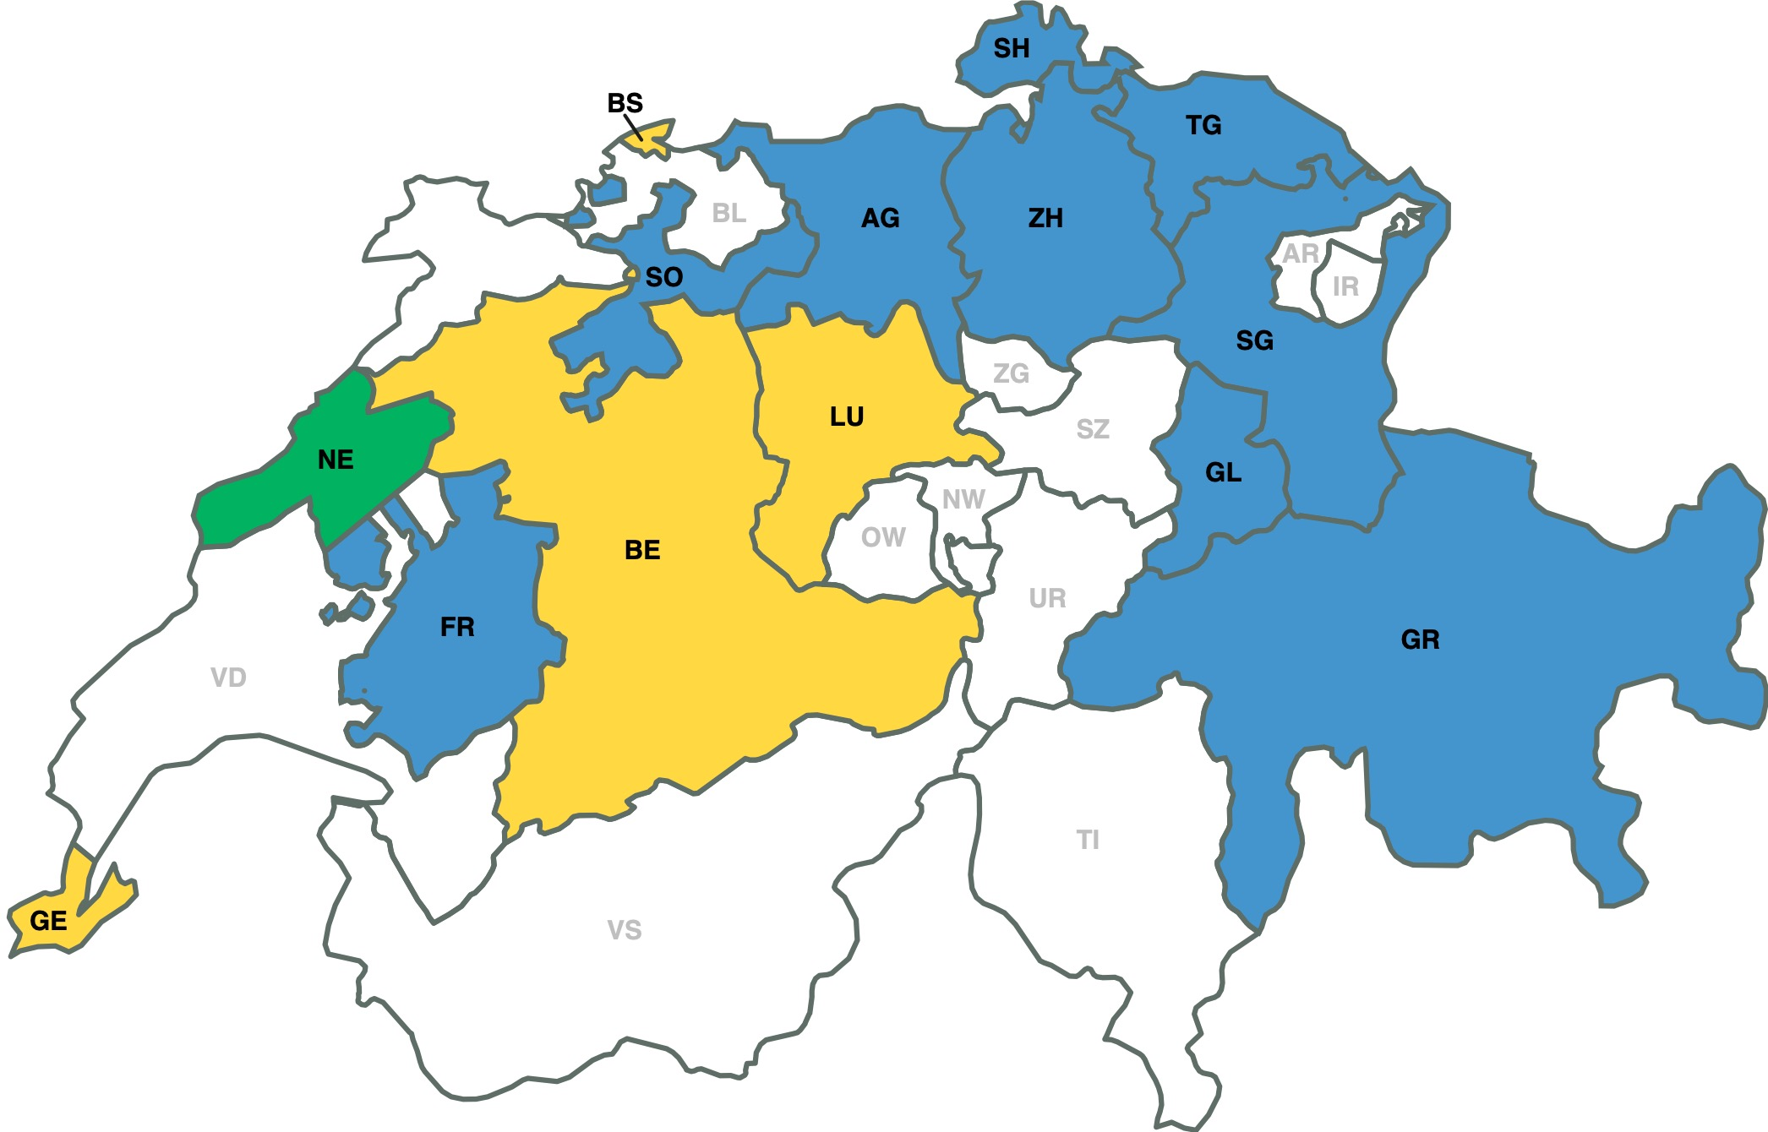
Extension of Swiss-wide Pilots
2009 Foundation Consortium Voté Electronique
2005 Neuchâtel System
first trials for federal votes
2009-2011 Geneva System
Agreements between Geneva and the cantons of Basel-Stadt, Lucerne and Berne for Swiss living abroad

Slide 13
Situation as of 2011
Geneva System
  Canton owns the SW and operates the system
  Developed by Geneva IT Department
  Voting Protocol by Bern University of Applied Sciences
Zürich / Vote Électronique Consortium System
  Canton owns the SW, external company (Unisys) operates it.
  Developed by Unisys
Neuchâtel System
  Canton owns the SW and operates the system
  Developed by Scytl
  Embedded in „Guichet unique“, as one of many offerings

Slide 14
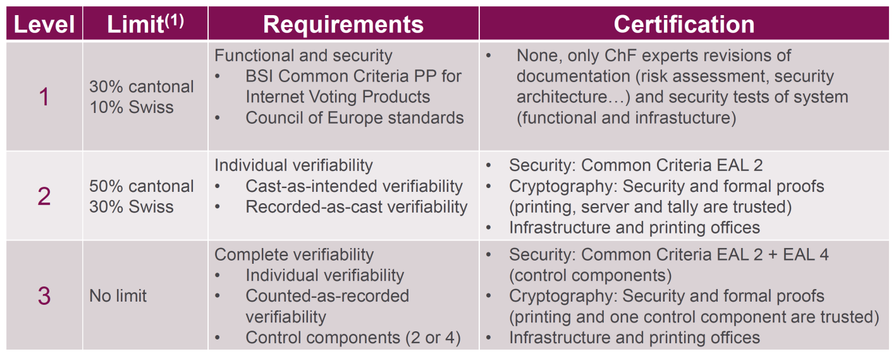
New Swiss Regulations in 2014 (VEleS)
In 2013 new regulations regarding REV in CH
  Federal Chancellery Ordinance on Electronic Voting «161.116 - Verordnung der BK über die elektronische Stimmabgabe vom 13. Dezember 2013 (VEleS)»
Framework for authorization of voting systems with three different levels, linked to the amount of allowed electorate
Source: Defining a national framework for online voting and meeting its requirements: the Swiss experience, Jordi Puiggalí, Adrià Rodríguez Pérez, E-VOTE ID 2018
Notes:
Requirements eingehen

Slide 15
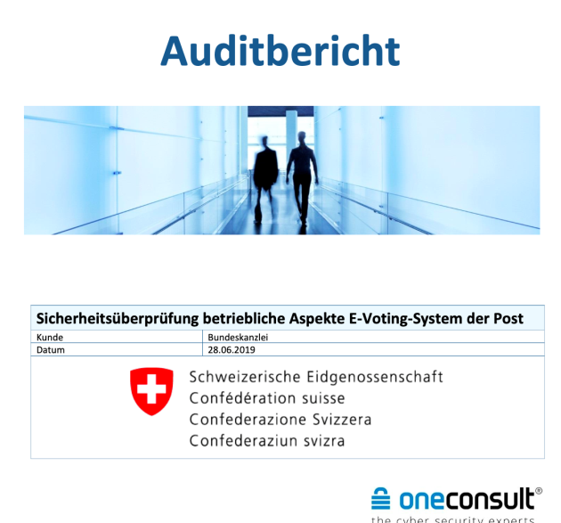
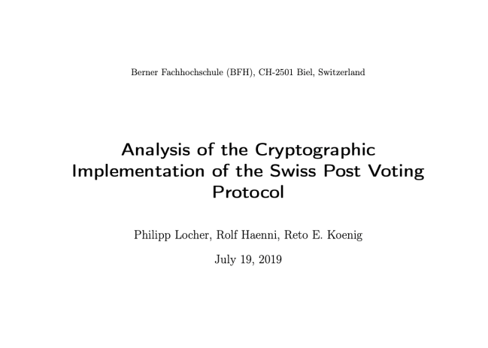
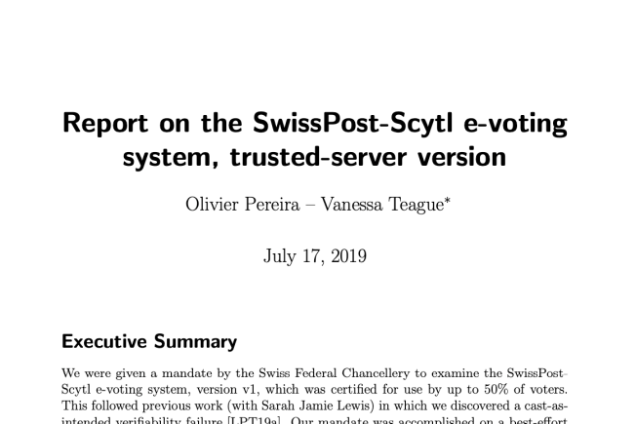
Publication of Source Code 2019
Publication of the source code in February 2019, researchers have uncovered significant security flaws in the new, fully verifiable, system provided by Swiss Post (sVote, developed by Scytl)
  One of the security issues relates to individual verifiability and thus to the system already used. As a result, the system was not available for the vote on 19 May 2019.

Slide 16
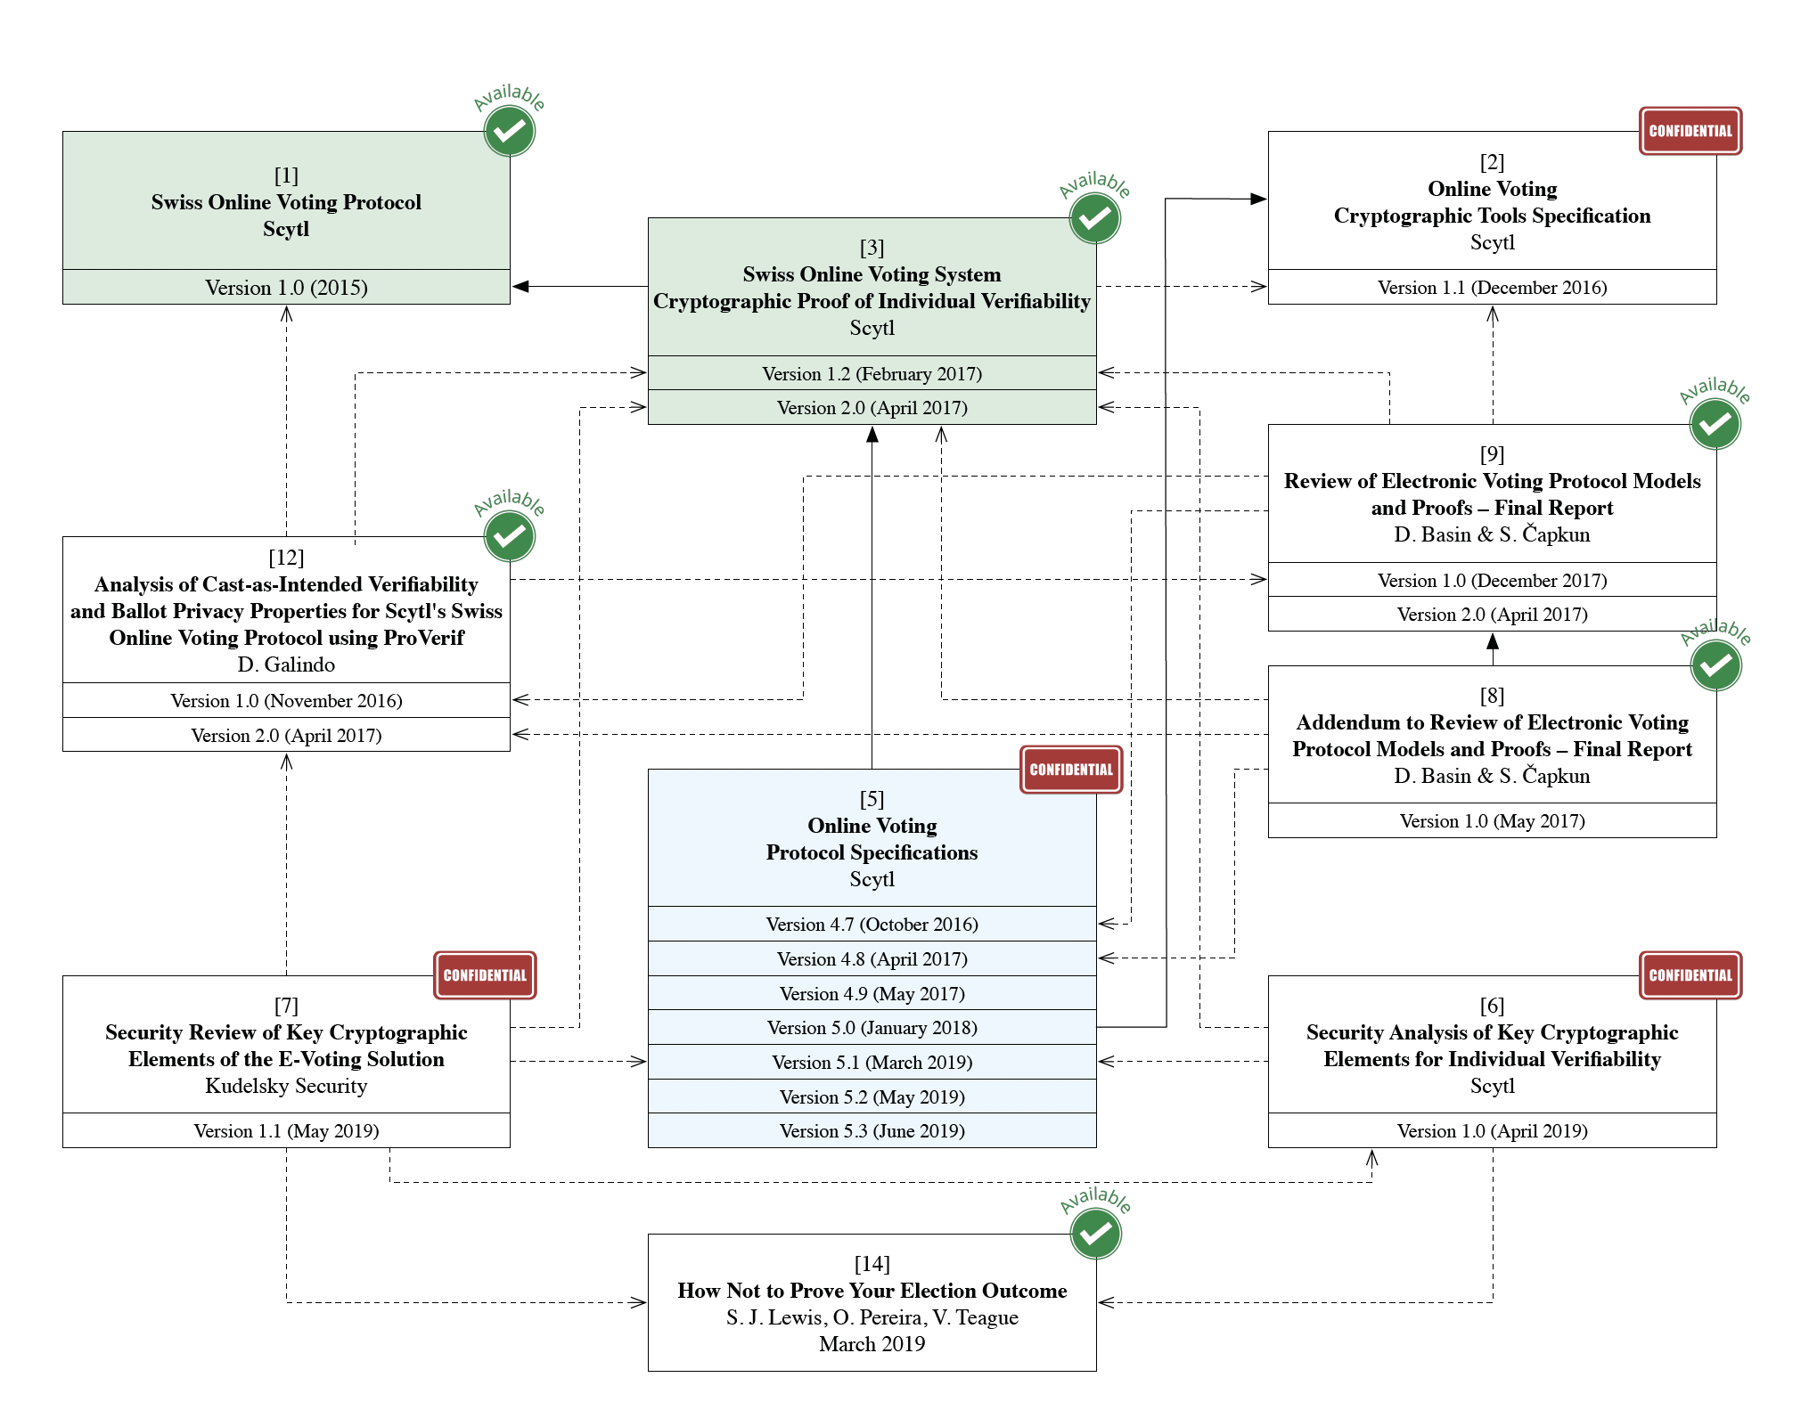
sVote Dependencies
Source: Analysis of the Cryptographic Implementation of the Swiss Post Voting Protocol, Philipp Locher, Rolf Haenni, Reto E. Koenig, https://www.bk.admin.ch/bk/en/home/politische-rechte/e-voting/berichte-und-studien.html

Slide 17
The Swiss Postal Voting System
TODO CK: Insert condensed version of PVPF in here, may flow nicely over from the „svote problems“ to the „initiative“ which is also chronologically correct
VL – Jede ebene – TUT nicht jede ebene
At the end, the conclusion may draw the question how we can “do“ REV properly, and helps motivate towards the formal requirements (next slide)

Slide 18


Advertisement on Public Initiative
Swiss public initiative on a “Secure and trusted democracy”
Notes:
CK: Political Debate that partially initiated this work.
In CH Initiative to "temporarily ban" REV efforts

Slide 19
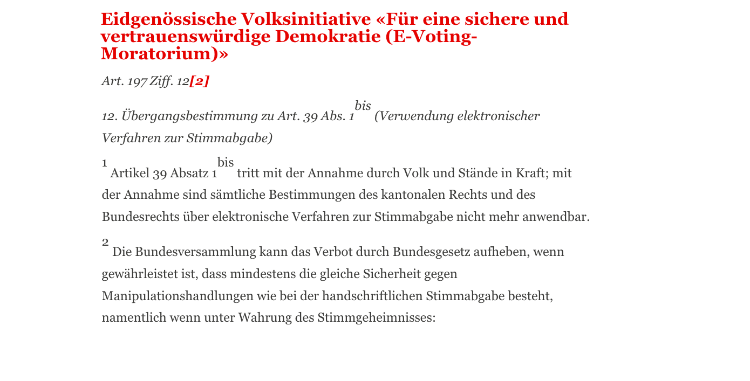
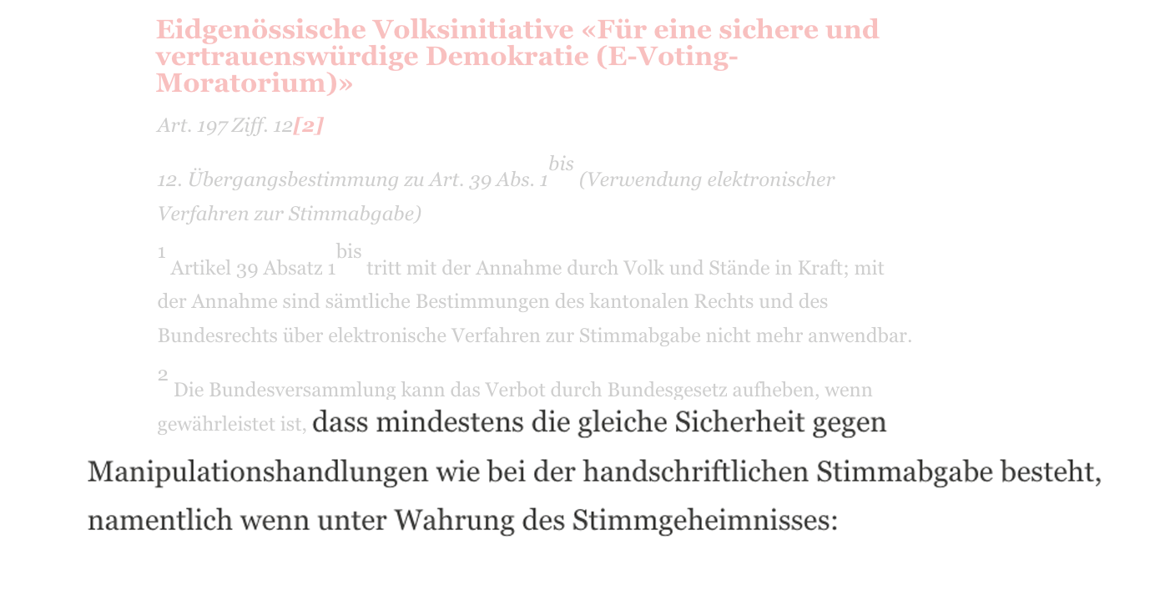
Proposed Law
... if it is guaranteed that at least the same security against manipulation exists as in the case of hand-written voting ...
Notes:
CK: Initiative clearly states: "ban can only be lifted, when traditional voting methods are as secure against tampering as handwritten ballot casting"
Key Question: what exactly does such a minimal level of security involve? Which security metrics and mechanisms are mandatory?

Slide 20

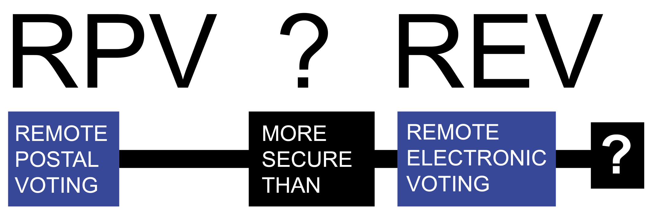
Comparing “Systems“
Notes:
CK: Provocative - So it's clear, right: RPV is more secure than REV.
But is it really? What's the full picture?

Slide 21
The Swiss RPV Case
The Swiss RPV is fragmented and difficult to generalize, due to federalism in Switzerland, autonomy, and involvement of many external suppliers
Goal:
To identify weaknesses of RPV to allow for “hardening” of the RPV through security and risk assessment.
  Disclaimer: Focus on generalization, may not cover all cantons and processes exactly, leaves room for exceptions.
  Many exchanges with Swiss authorities and external suppliers
[ KS19] C. Killer, B. Stiller: The Swiss Postal Voting Process and Its System and Security Analysis, E-VOTE-ID 2019
Notes:
CK: So, in a more formalized manner
The Swiss RPV is fragmented, difficult to generalized due to federalism.
Autonomy and Involvmenet of many stakeholders, authorities and external suppliers.
Goal: Penetration Testing approach, Disclaimer again

Slide 22

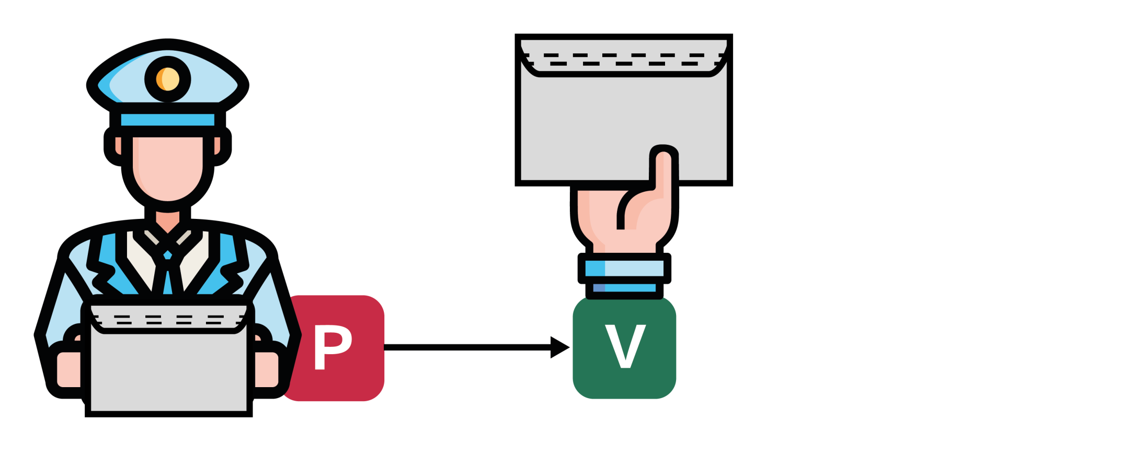
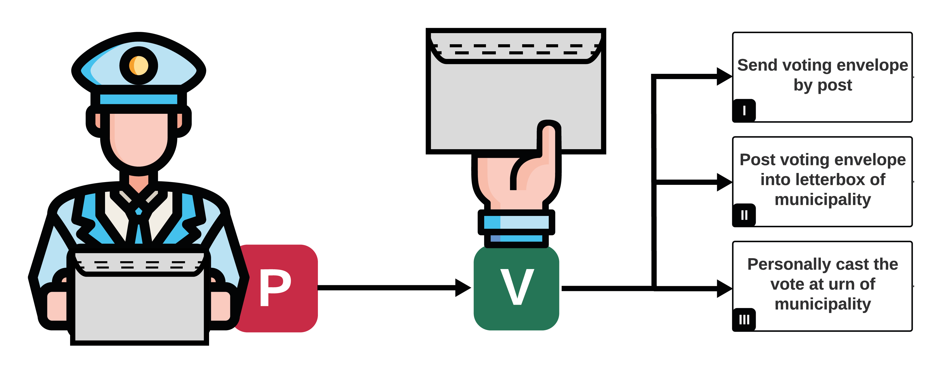
RPV From a Voter’s Perspective
RPV: Remote Postal Voting
Notes:
CK: From a voter's perspective

Slide 23
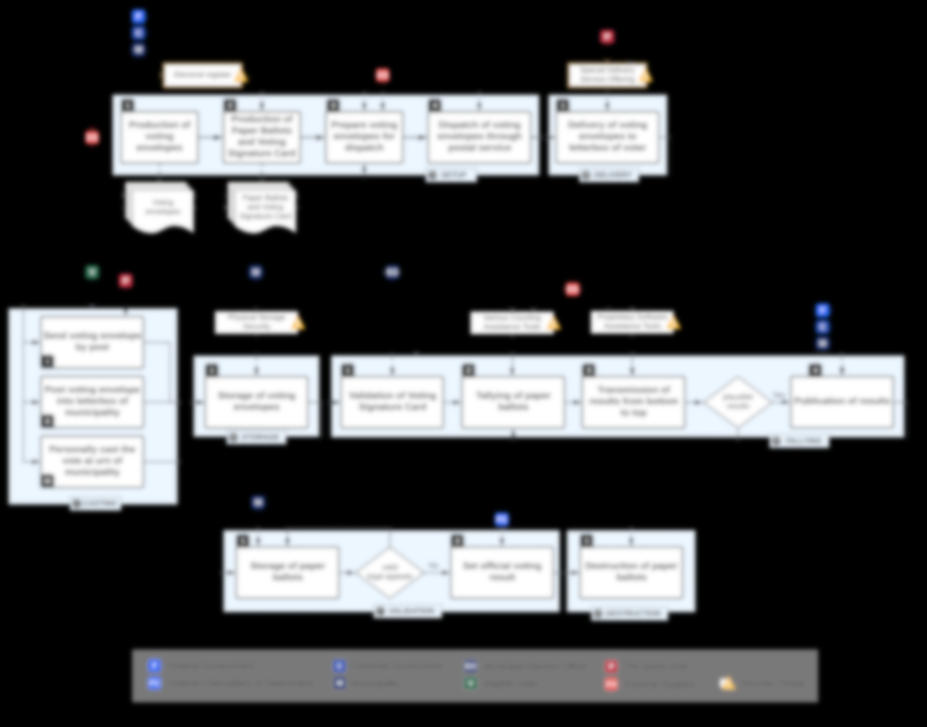
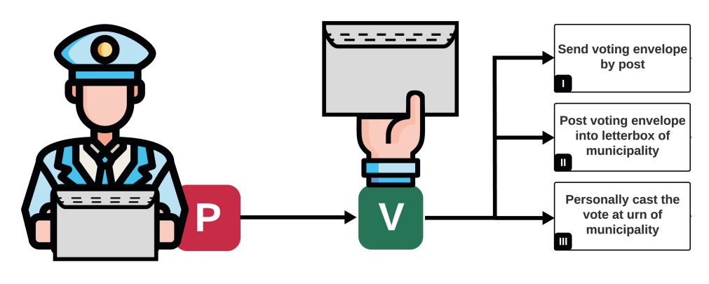
PVPF: Postal Voting Process Flow
Notes:
CK: As seen: this decision is just one part of a huge process flow
This talk will focus on clarifying the image of the process.

Slide 24




















Identification of Stakeholders
Federal Government
?
Federal Chancellery
Cantonal Government
?
Municipality
?
Municipal Election Office
Eligible Voter
?
The Swiss Post
External Supplier
Security Threat
Notes:
CK: So let's identify stakeholders, we only have two by now. But who are the others??

Slide 25
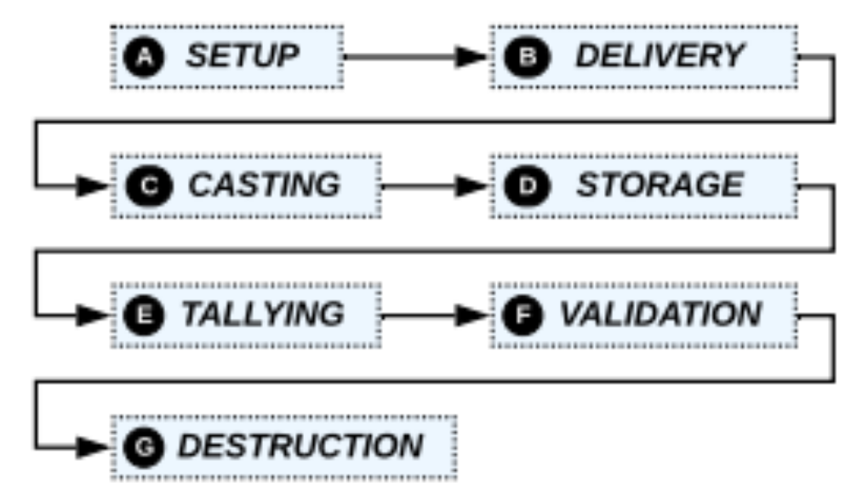
PVPF Phases
Divided into phases A to G with various stakeholders
Federal Government
Federal Chancellery
Cantonal Government
Municipality
Municipal Election Office
Eligible Voter
The Swiss Post
External Supplier
Security Threat
PVPF: Postal Voting Process Flow
Notes:
CK: Now let's map the process out, we have A to G

Slide 26
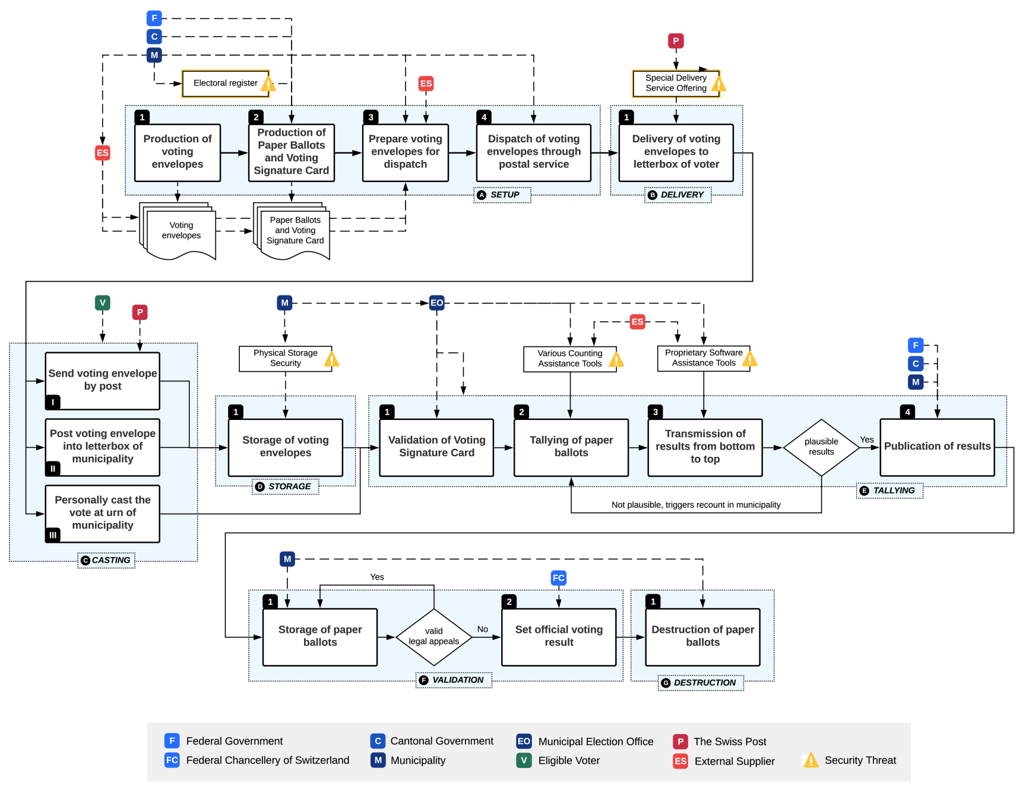
PVPF in Detail
PVPF: Postal Voting Process Flow
[ KS19] .
Notes:
CK: As seen: this decision is just one part of a huge process flow
This talk will focus on clarifying the image of the process.

Slide 27
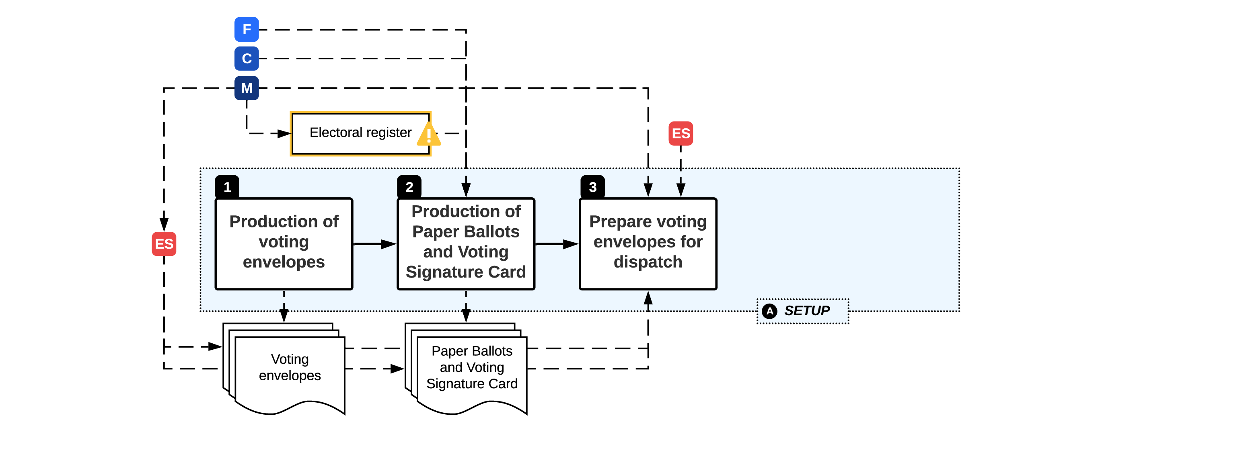
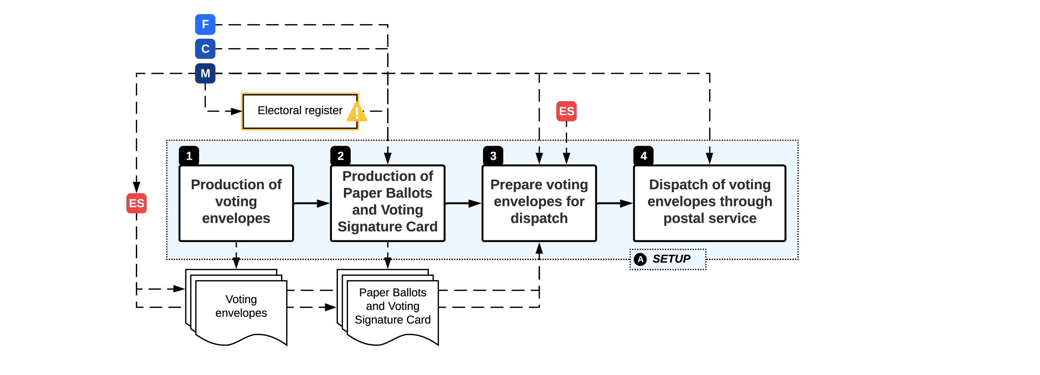
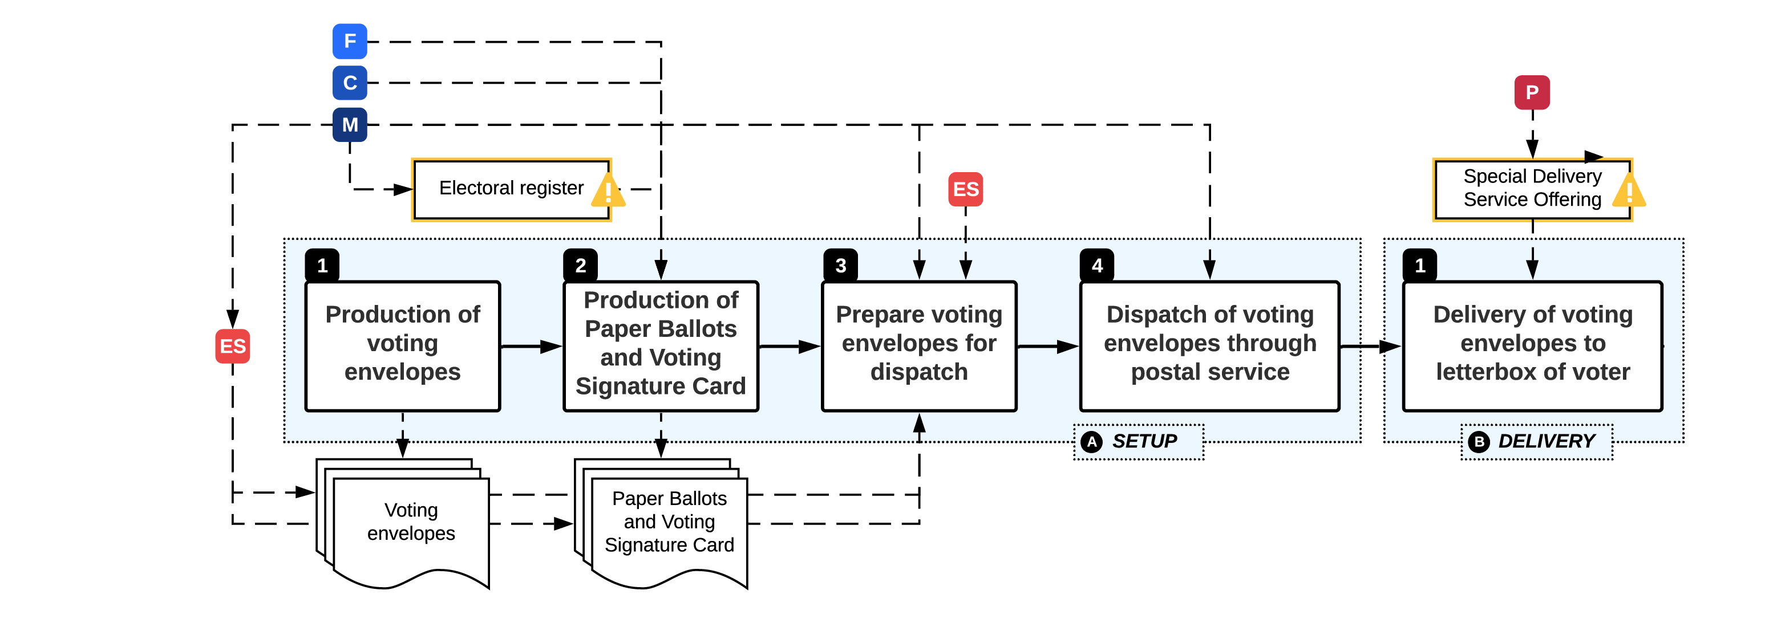
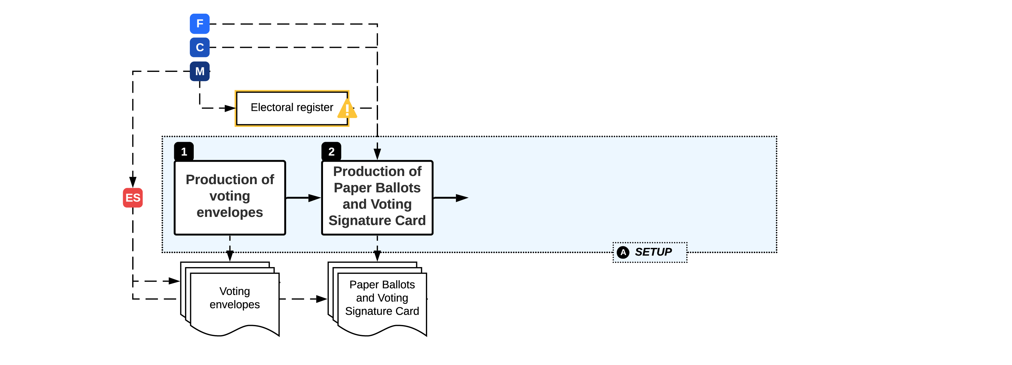
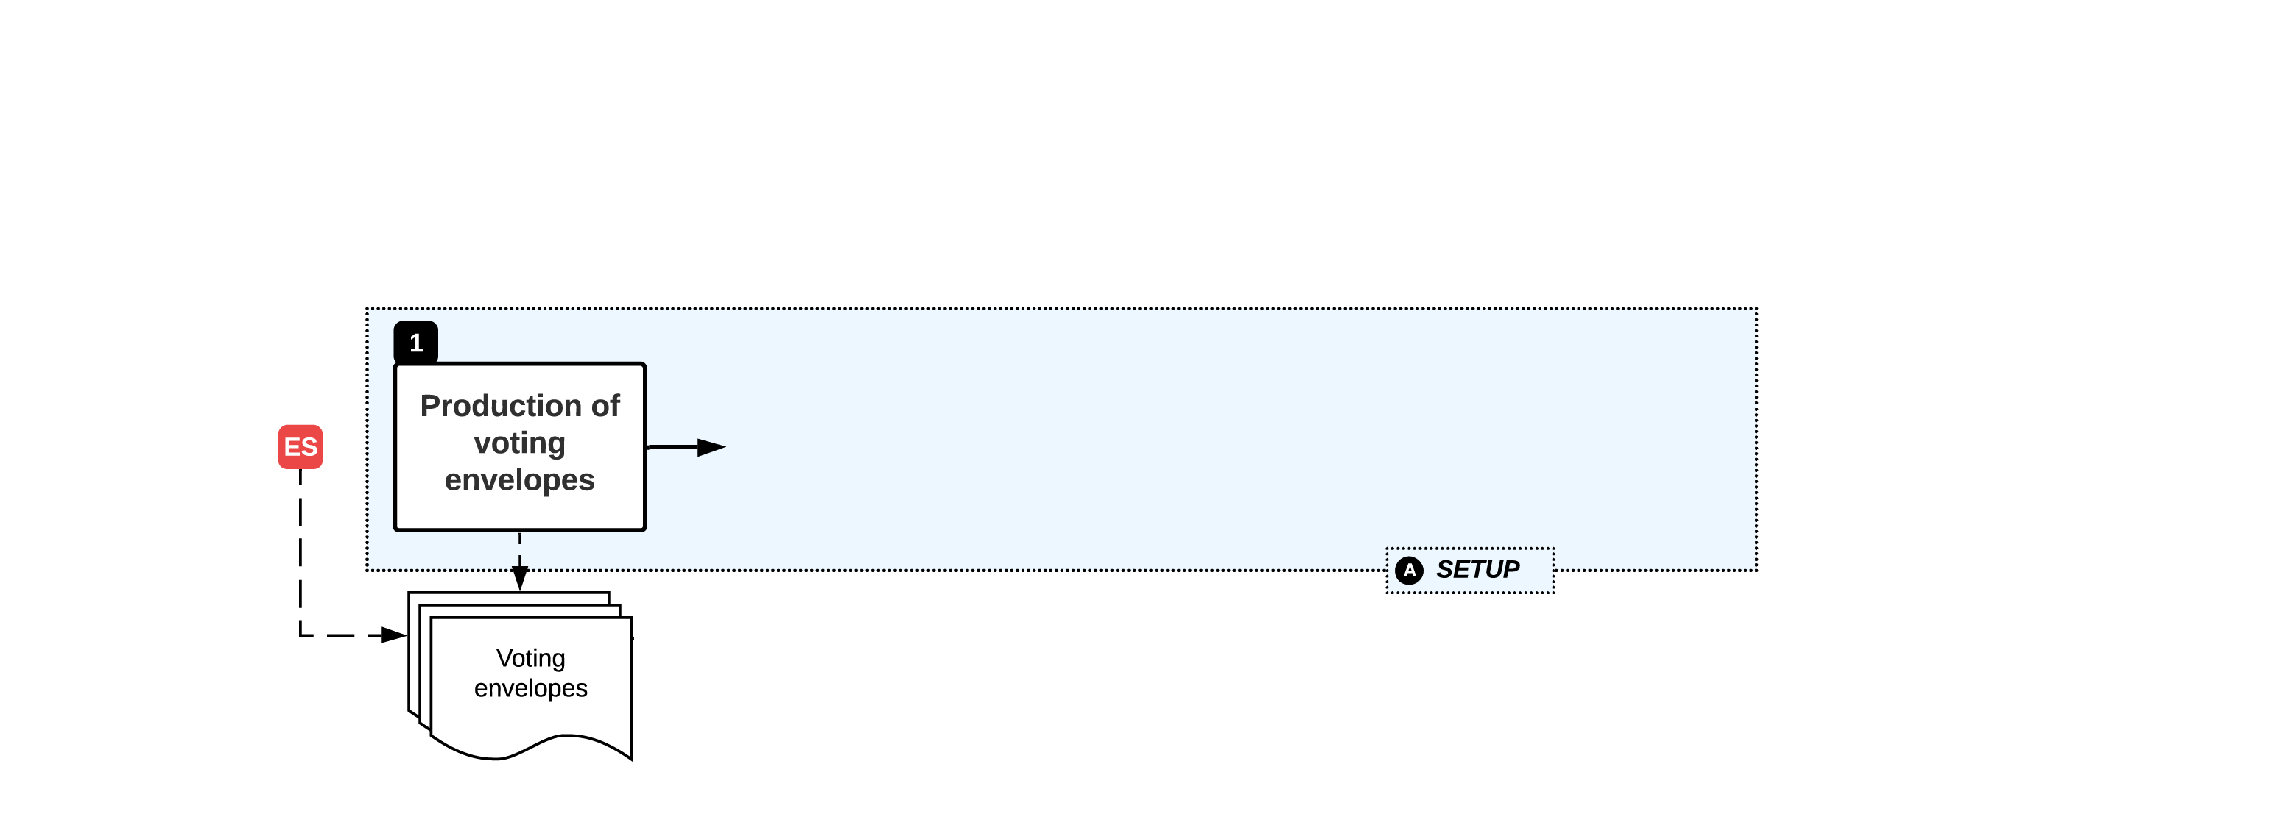
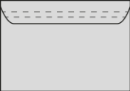



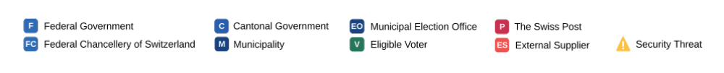
A: Setup, B: Delivery
[ KS19] .
Notes:
CK: A1) Start off at the very beginning: prod.of VE
A2) Paper Ballots and VSC also needs to be printed according to the templates provided by each "political layer" and according to an Electoral Register which most of the time is a "snapshot" of the citizen register, but effectively stems from a single-source of truth in the municipality.
A3) Depending on the canton, another ES involved.
A4) Actual dispatch of the Ves – change of hands again
A5) out of scope – black box

Slide 28



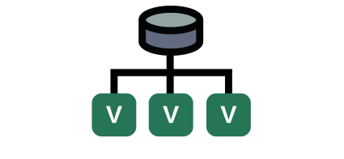
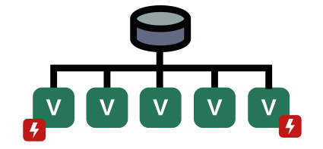

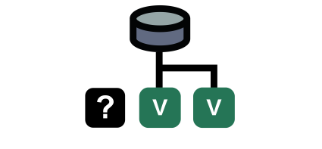

A: Setup, B: Delivery
THREAT EVENTS
TE1: Delay production of physical artifacts
TE4: Forge physical artifacts
TE6: Re-route VEs
TE2: ER master records
TE3: ER snapshot data
TE5: Steal assembled VEs before dispatch
TE7: Steal VE from voter letterboxes
Notes:
ML: Focus on TE2, TE3 and TE5

Slide 29
PVPF in Detail
PVPF: Postal Voting Process Flow
Notes:
CK: Let's widen the scope, we already had the top third. Now we look at the middle lane.

Slide 30
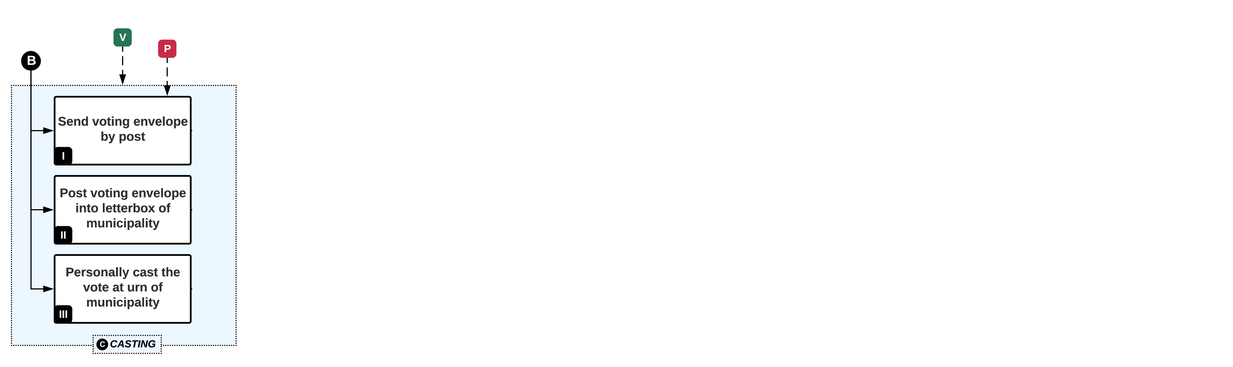
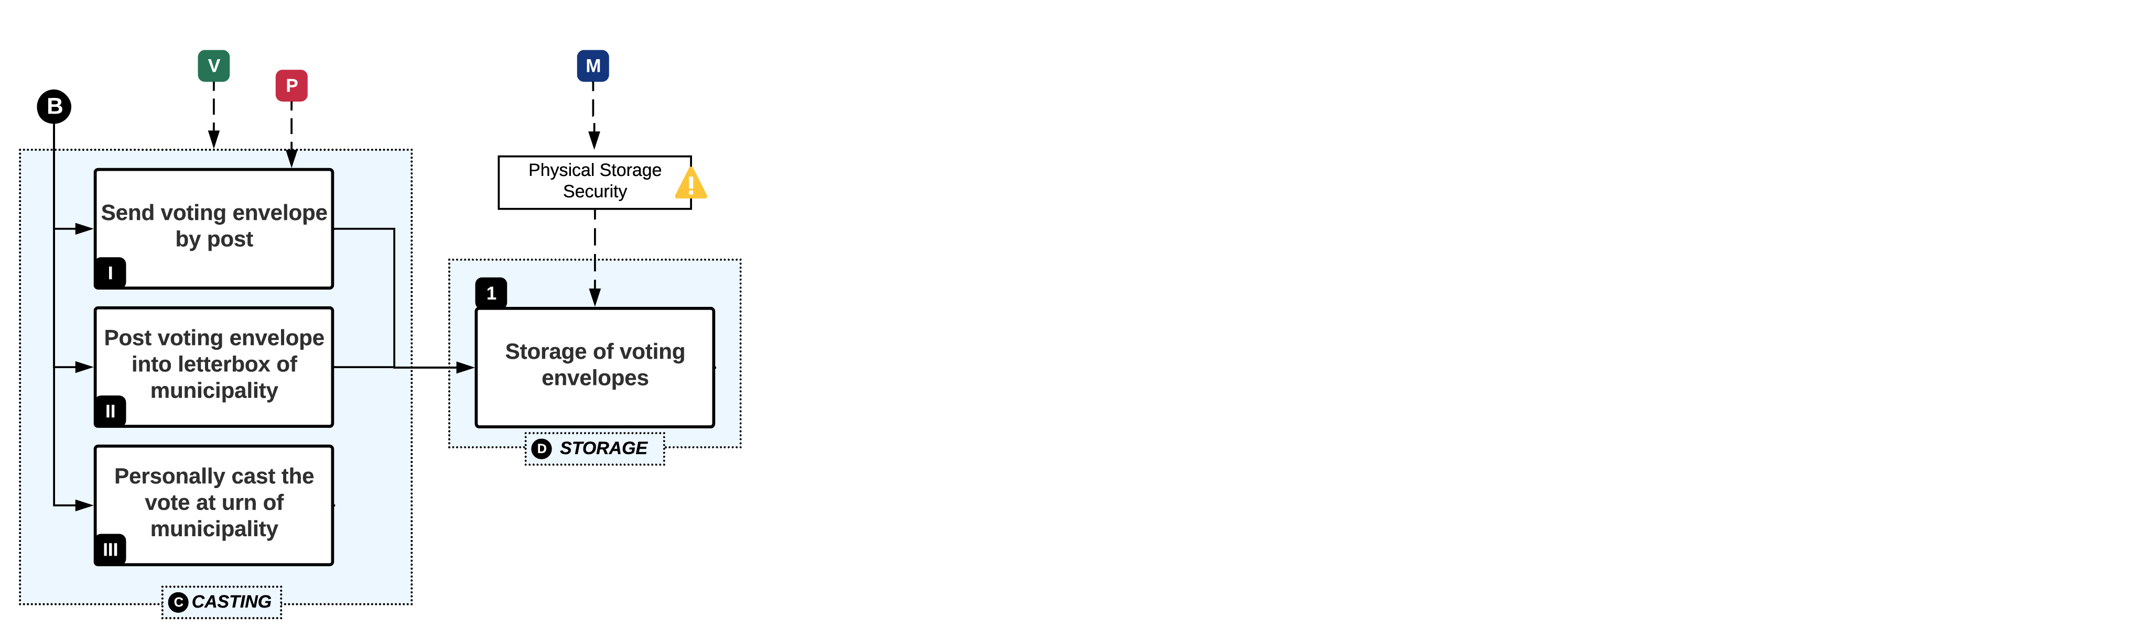
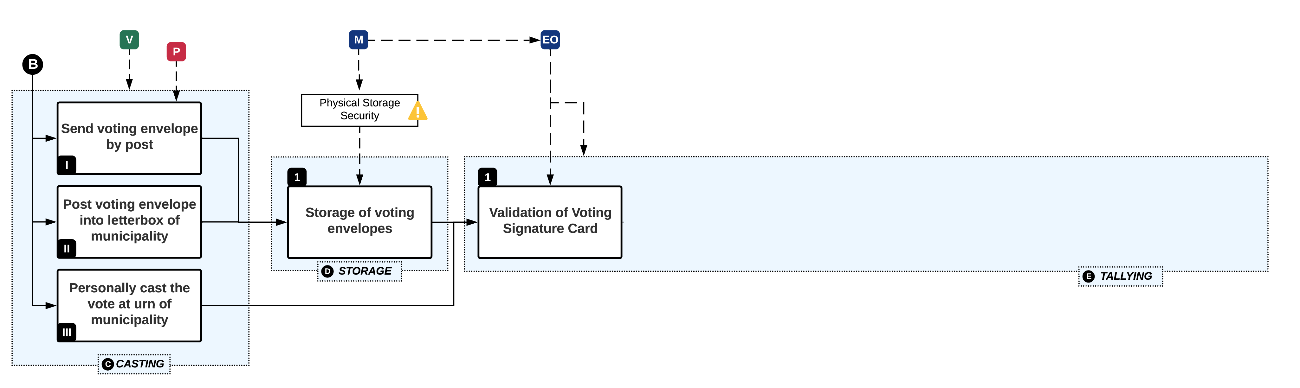
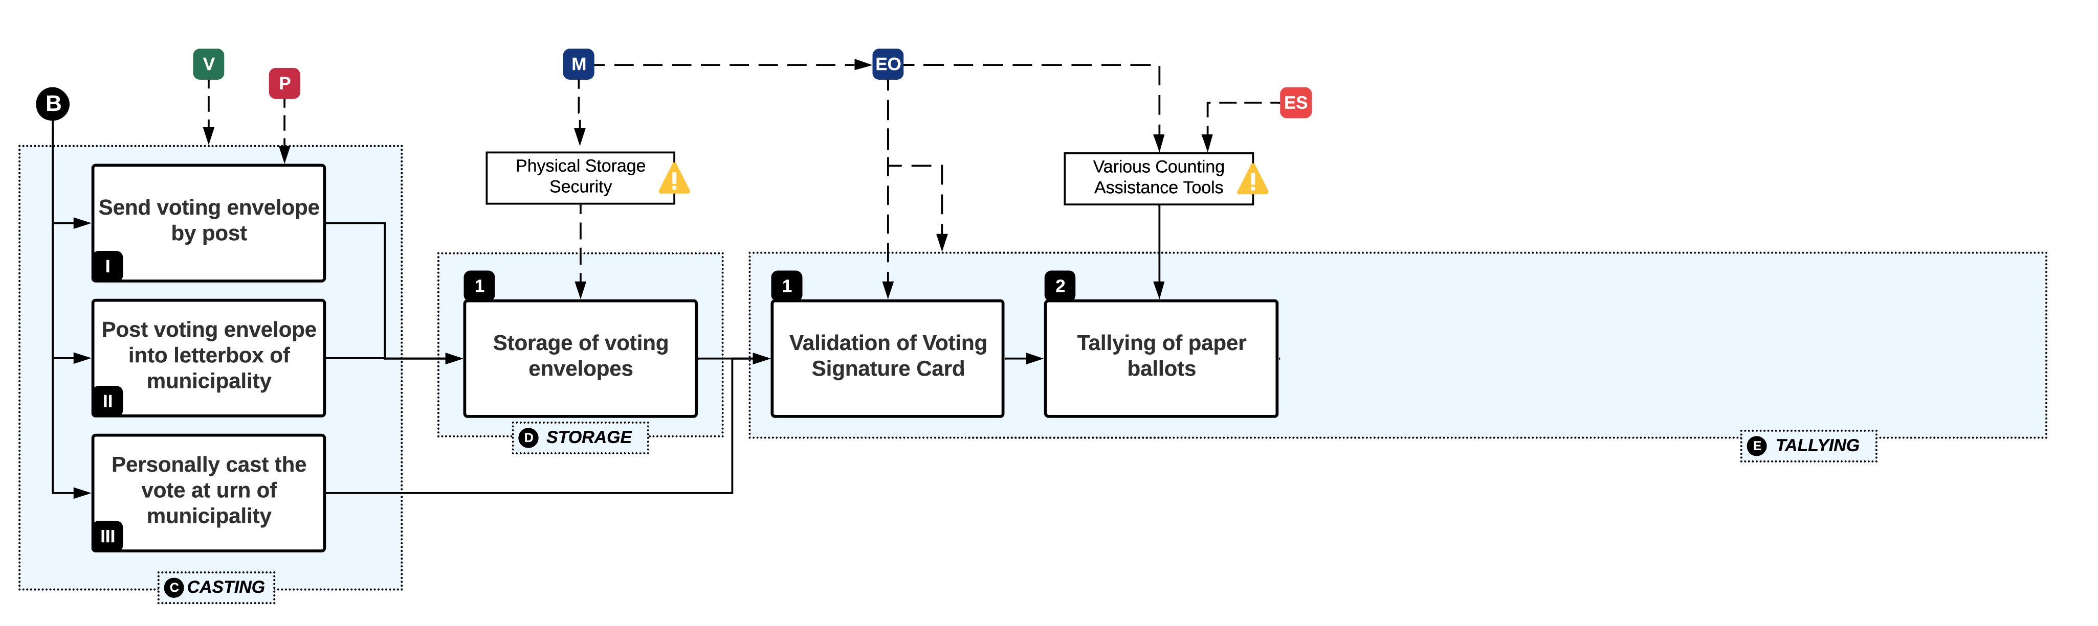
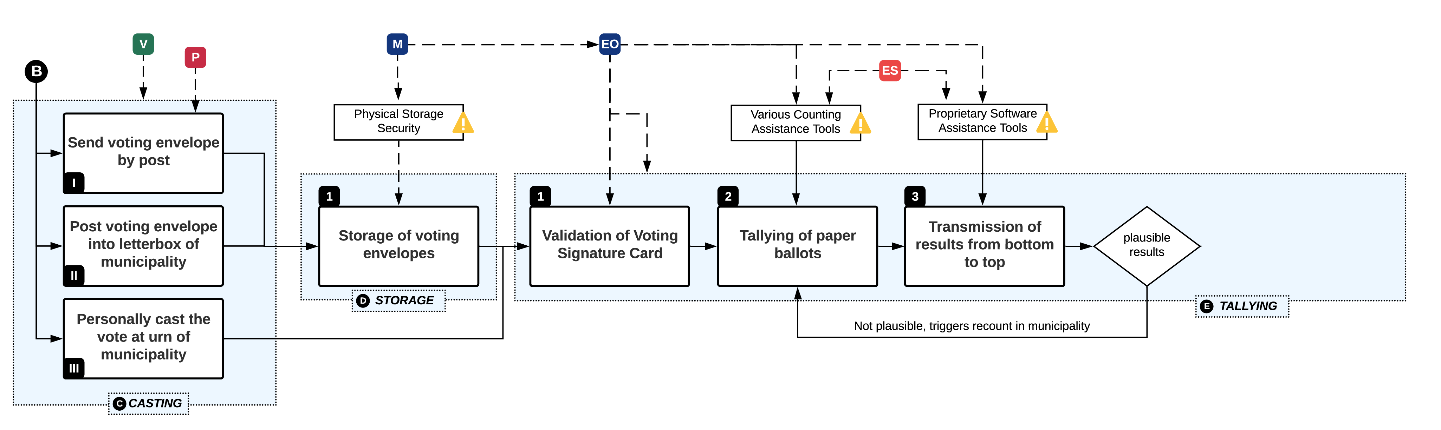
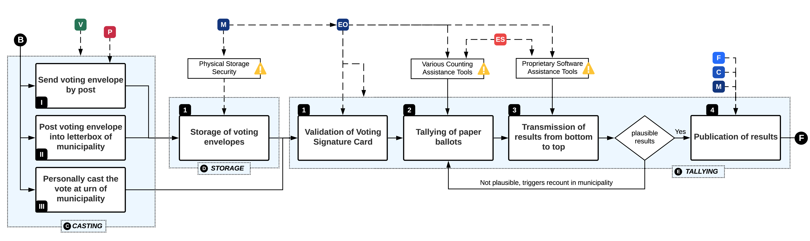
C: Casting, D: Storage, E: Tallying
Notes:
CK: Freestyle

Slide 31
C: Casting, D: Storage, E: Tallying
THREAT EVENTS
TE10: Cast stolen or forged VEs
TE9: Re-route VEs
TE12: Manipulate tallying
TE11: Access stored VEs
TE13: Manipulate final tally
TE8: Steal casted VEs from municipal letterbox
Notes:
ML: Focus on TE11, 12, 13 – which are split up across the next three slides

Slide 32
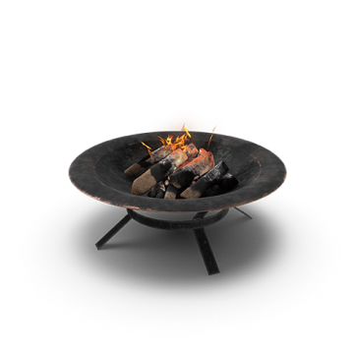




C: Casting, D: Storage, E: Tallying
THREAT EVENTS
TE12: Manipulate tallying
TE11: Access stored VEs
TE13: Manipulate final tally
Notes:
ML

Slide 33






C: Casting, D: Storage, E: Tallying
THREAT EVENTS
TE12: Manipulate tallying
TE13: Manipulate final tally
Notes:
ML

Slide 34


C: Casting, D: Storage, E: Tallying
THREAT EVENTS
Phishing
Physical Access
File Shares
Weak, stored or default credentials
Known vulns
Authentication Protocol Abuse
Plaintext connections
TE13: Manipulate final tally
Notes:
ML

Slide 35


PVPF Full Threat Map
THREAT EVENTS
Notes:
ML

Slide 36












Conclusions on the Swiss RPV
Heterogeneous Processes
Distribution of Trust and Physical Decentralization
Substantial Trust in Third Parties
Notes:
CK:Physical decentralization and distribution of trust as main strength of Swiss RPV
Concentration of Trust in TTP across Process, even though the process would be distributed in itself.
ML:
One Penetration Tester does try to identifiy paths within his individual capabilities and within the allocated time. If we wanted to approximate a map of all the best paths, we needed to consider a lot of fragments and attempts to build full paths. The more Penetration Tests, the better the map. Paying a lot of Penetration Testers only for new paths or fragments of paths is called Bug Bounty Program. In Bug Bounties, each Penetration Tester can focus on his core capabilities. Some attackers are very fast on Highways. Some attackers rather climb mountains. Others do dig tunnels. A group of attackers, who join their abilities together, will come up with amazing new attack paths.

Slide 37
RPV ? REV
RPV
  No privacy guarantees, trust in “counters“
  No verifiability, once my vote is cast
So what about REV?

Slide 38
Theoretical Properties
Notes:
Cloud computing
- History / Definition / characteristics
- IaaS, PaaS, …
Virtualization
- TBD (GM)
38

Slide 39
REV Requirements (1)
Privacy
  A vote must not identify a voter and any traceability between the voter and its vote must be removed
Verifiability
  A voter should be able to verify if its vote was correctly recorded and accounted for in the final vote tally
Absolute privacy (no information leaks) cannot coexist concurrently with verifiability (sufficient information leaked to verify the result)
  Goal of voting system design is to find a way to enable as much privacy and verifiability simultaneously as possible

Slide 40
REV Requirements (2)
Robustness
  provide resistance against a certain degree of malfunction or corruption and still deliver correct results.
Usability
  cast votes through a convenient and accessible interface, providing equal opportunity for access and participation

Slide 41



Voting and Electoral Processes

Slide 42

Privacy and Verifiability Notions
A voter cannot gain information which can be used to prove, to a coercer, how she voted.
A voter cannot collaborate, with a coercer, to gain information which can be used to prove how she voted.
A voter’s vote is not revealed to anyone.
Against:
Forced abstention,
Forced randomised voting
Forced to give up voter credential
A voter can check whether their ballot is collected.
Anyone can check, whether an outcome corresponds to votes expressed in ballots collected.

Slide 43
End-to-end Verifiability
End-to-end Verifiability “consist” of
Cast-as-Intended
  The voter’s choice was correctly denoted on the ballot by the system
Recorded-As-Cast
  The voter’s ballot was received the way she cast it
Tallied As Recorded
  The Voter’s ballot counts as received

Slide 44
Fairness and Unforgeability
Fairness
  concerns the impossibility to deduct a partial tally, before the end of the vote casting period.
  REV schemes should not allow for intermediate results, which potentially influence voters that have not voted yet.
Eligibility Verifiability [KR ⁺ 10]
  ﻿anyone can check that each vote in the election outcome was cast by a registered voter and there is at most one vote per voter
Unforgeability [Smy18]
  ﻿Only eligible voters can construct authorised ballots.

Slide 45
Software Independence
Software Independence
  A voting system is software-independent if an undetected change or error in its software cannot cause an undetectable change or error in an election outcome
Addresses the difficulty of verifying
  Complex software in a completely electronic voting systems
Problem: providing assurance that the voting software is in fact correct
  Verify the election results, not the voting system

Slide 46
Refinements of Software Independence
Weak Software Independence
  A voting system that is weakly software-independent conforms to the basic definition of software-independence, that is, there is no recovery mechanism
Strong Software Independence
  A voting system is strongly software-independent if an undetected change or error in its software cannot cause an undetectable change or error in an election outcome, and moreover, a detected change or error in an election outcome (due to change or error in the software) can be corrected without re-running the election

Slide 47
REV Building Blocks (1)
Secret-Ballot Voting Schemes, i.e., voting protocols describing the process
Cryptographic Primitives, i.e., procedures used in the protocols to assure privacy and verifiability
Public Bulletin Board (PBB), i.e., ballot box saving all results and logs of the procedures, making the process verifiable

Slide 48


Building Blocks for REV Schemes

Slide 49

Secret Ballot Voting Schemes
BP: Ballot Privacy
RF: Receipt-
Freeness
CR: Coercion-
Resistance
EBP: Everlasting
Ballot-Privacy
BS: Blind Signatures
HE: Homomorphic
Encryption
MC: Multiparty
Computation
MN: Mixnet
CS: Commitment
Scheme
Based on „Privacy and Verifiability in Voting Systems” by H. Jonker 2013

Slide 50

FOO92

Slide 51
CGS97
TODO for Tutorial

Slide 52
SK95
TODO for Tutorial

Slide 53

Homomorphic Encryption
Homomorphic Encryption (HE)
${enc}_{k }\left(m_{1}\right)⨂{ }{enc}_{k }\left(m_{2}\right)=$ ${enc}_{k }\left(m_{1}⨁{ m}_{2}\right)$
      $⨂{ }appropriate operation on ciphertext messages$
      $⨁{appropriate operation on plaintext messages}$
Allows two encrypted messages to be combined meaningfully (by using $⨁$)
The actual operations represented by and $⨁$ depend on the used cryptographic system.

Slide 54

Homomorphic Encryption
In REV, HE used to tally votes
Every eligible voter $V$ can encrypt his or her $vote$ using the election public key $pk$, resulting in the encrypted vote: ${enc}_{pk }$(${vote}_{V}$).
No individual votes need to be decrypted, because the votes can be added together homomorphically.
Thus, the final, encrypted tally is
${enc}_{pk }\left({vote}_{1}\right)⨂{…⨂{ }}{enc}_{pk }\left({vote}_{n}\right)=$ ${enc}_{pk }\left({vote}_{1}⨁…⨁{ vote}_{n}\right)$

Slide 55
Proving Ciphertext Validity
But how do we tackle the encryption malleability?
  i.e. What happens if I encrypt 100 instead of 1?
  We need a way to assure the validity of the ciphertext, while assuring Ballot Privacy.
Zero Knowledge Proofs!
    Each voter proves that she cast a valid vote, without revealing her vote.
    The authorities prove that they know their secret keys (that match the election public keys), without revealing their secret keys.
    At the end of the election, the authorities prove that they have tallied correctly (decrypted the result correctly), again without revealing their secret keys.

Slide 56
ElGamal Cryptosystem
TODO for Tutorial
In practise, the basic encryption and decryption algorithms of ElGamal need to be slightly adjusted to make the scheme additively homomorphic
Generally viable theoretical part + instantiation
TODO: Describe KeyGen, Enc, Dec for Additive Elgamal Cryptosystem

Slide 57
Discrete Logarithm Assumption
TODO for Tutorial
The generation of prime numbers is needed for almost all public key algorithms, for example
  In the RSA encryption system we need to find primes p and q to compute the public key N = p * q.
  In ElGamal encryption we need to find primes p and q with q dividing p − 1.
Why prime numbers? Because exponentiation with prime numbers is extremely hard to invert → trapdoor function

Slide 58

The Role of Cryptographic Assumptions
TODO for Tutorial
TODO: relate to this in one bullet, why it‘s relevant, not explain in full
Computational Diffie Hellman (CDH)
Decisional Diffie Hellman (DDH)

Slide 59

Zero Knowledge Proofs
Zero Knowledge Proof is a proof of a statement $s$ which reveals nothing about statement $s$, except that it is true
  With the use of a ZKP system, a prover $P$ can convince a verifier $V$ via an interaction that some statement $s$ is true.
Non-interactive Zero Knowledge Proofs
  This relies on the prover generating a (to him) unpredictable challenge (which cannot be tweaked) based on his commitment and public knowledge, such as the hash of the commitment.
  In REV: (NI)ZKPs enable a voter to verify that her vote is valid, being able to prove to an outsider what she voted.

Slide 60

Ali Baba‘s Cave (1)
The cave has a single entry and is shaped like a ring with two paths (A and B) and contains a hidden door separating the two paths
Peggy knows the password to open the hidden door but does not want to reveal it
To prove to Victor, the verifier that Peggy knows the password, Peggy enters the cave and chooses a path.

Slide 61
Ali Baba‘s Cave (2)
Next, Victor enters the cave and demands that Peggy exits the cave using path A or B, chosen at random.
  Since P knows the password it is trivial for it to pass the test. On the other hand, had P not known the password, she would have only had a 50% chance of returning from the demanded path.

Slide 62
Ali Baba‘s Cave (3)
Victor can challenge Peggy multiple times, thereby decreasing the probability of Peggy being a fraudulent prover by a factor of two every time
  Therefore, Victor can repeat this process as many times as deemed necessary until the desired level of confidence is obtained

Slide 63
What‘s next
By employing HE, we now can assure Ballot Privacy and assure that authorities can keep their secret keys private, while homomorphically tallying the final result, proving correct decryption.
How can we achieve individual and universal verifiability?
Public Bulletin Boards!

Slide 64
From Interactive to Non-interactive
TODO for Tutorial -- Random Oracle Model, why this works and what it means for a ZKP proof of validity for elgamal encryption in the specific case

Slide 65
BC-based REV System: Provotum
REV systems often rely on centralized infrastructures, operated by trusted parties
Blockchain-based REV system would enable to decentralize trust
  Using a Public Permissioned BC serving as a transparent, immutable, tamper-proof and decentralized, enabling public End-to-End (E2E) Verifiability
[KRM20] C. Killer, B. Rodrigues, R. Matile, E. Scheid, B. Stiller: Design and Implementation of Cast-as-Intended Verifiability
for a Blockchain-based Voting System. ACM SAC 2020.

Slide 66
Public Bulletin Board (PBB)
PBB serving as a
  shared, append-only data structure
  public and searchable by anyone
  consistent view for anyone accessing its information
In practice, a public permissioned Blockchain (BC) fulfills those theoretical requirements
[KRM20].
Notes:
The Public Bulletin Board is a central component of any REV system
Serving as a shared, append-only data-structure (immutable)
Therefore, a scientific contribution of this thesis is the actual design and implementation of BCs as PBBs, and the evaluation with which schemes, privacy assumptions that is actually compatible

Slide 67


Public Permissioned Blockchain (BC)
Deployment of a Public Permissioned BC
  Read operations: Public
  Write operations: Permissioned
[KRM20].

Slide 68


The Swiss Scenario
The Federalism of Switzerland serves as a suitable framework for a decentralized BC-based REV system
[KRM20].
Notes:
Cantons have authority over the political system
The political system is under the authority of the cantons, i.e., cantonal laws
and ordinances regarding political rights dene elements for these processes.
Various aspects of those elements are relevant for the RPV system in Switzer-
land, and each canton has its own decrees regarding political rights. The federal
structure is mirrored down to the municipal level: each municipality decides
on certain processes, again, aligned to cantonal laws and decrees. For instance,
keeping record of the electoral register is under the authority of municipalities,
leading to di
erent approaches.

Slide 69

Provotum 2.0

Slide 70

Provotum 2.0 Identity Provisioning

Slide 71

Voting Protocol: Registration (1)

Slide 72

Voting Protocol: Registration (1)

Slide 73

Voting Protocol: Pairing (2)

Slide 74

Voting Protocol: Pairing (2)

Slide 75

Voting Protocol: Key Generation (3)

Slide 76

Voting Protocol: Key Generation (3)

Slide 77

Voting Protocol: Voting (4)

Slide 78

Voting Protocol: Voting (4)

Slide 79

Voting Protocol: Tallying (5)

Slide 80

Voting Protocol: Tallying (5)

Slide 81
Evaluations Provotum 2.0
E2E-Verifiability and Ballot Secrecy achieved ✓
Client-Side Cryptography ✓
On-Chain Proof Verification ✓
Distributed Key Generation ✓
Cooperative Decryption ✓
Solidity EVM restricted to 256-bit integers ✗
Mitigate Identity provisioning scheme threats✗
Receipt-Freeness and Coercion-Resistance ✗

Slide 82
Summary
Remote Electronic Voting
  If trust is distributed in REV, then REV can offer better privacy and verifiability than traditional voting channels, under certain trust and computational hardness assumptions
    As soon as a system is public, future adversaries may be able to decrypt cipher-text
Achieving such trust distribution can be implemented by using a Public Permissioned Blockchain, where authorities collaborate with a Proof-of-Authority consensus

Slide 83
Other TODOS for Tutorial
Distributed Key Generation 1-2 Slides
Cooperative Decryption 1-2 Slides
Public Bulletin Board 2-3 Slides on Public Permissioned BC and why this use-case works (Flow over to Provotum part)
Provotum Stakeholders 1 Slides
Provotum Architecture 1-2 Slides
Provotum Voting Protocol 4 Slides
Provotum Evaluation (using all properties previously defined)

